Slide 1
Java Basics
Functional Programming in Java, Generics and Annotations & more…
Java workshop training, August,2017.
Dr. Kishore Biswas (Forrest/柯修)
PhD. Artificial Intelligence—Natural Language Processing.
CanWay IT Training ®.

Slide 2
7) Functional Programming in Java,
8) Generics and Annotations,
9) Principle for Usable Design & Usability Metrics.

Slide 3
7) Functional Programming in Java

Slide 4
Introduction
Functional programming (F.P.) is in some ways the opposite of object-oriented programming: focus is on functions, all data is passive -- in OO the data name is first: x.f(), while in functional programming the function name is first: f(x).
Functions can be used in F.P. like objects in OO: local functions are allowed, functions can be passed to other functions and returned as values, and functions can be created dynamically (functions are first-class values).

Slide 5
Pure Functional Programming
No variables, only constant values, arguments, and returned values.
No assignment or loops.
All functions are referentially transparent: the value of a function depends only on the value of its parameters (arguments) and not on the order of evaluation or the execution path that led to the call.
I/O is a problem, since any input function is not referentially transparent.

Slide 6
Notes and Examples
Any referentially transparent function that has no parameters must always return the same value. So random() and getchar() are not referentially transparent.
A purely functional sorting routine cannot sort an array in place -- it must create a new constant array with the sorted values.
In order to program effectively in a purely functional way, constant creation must be as general as possible. In particular, structured constants must be available.

Slide 7
Functional programming in an imperative language
Can one program functionally in C? Almost! The main problems are: insufficiently general functions, insufficiently general constants, problematic I/O.
Why would one want to do so? Easier to understand, more reliable code (why?). But some situations are not suitable, e.g. sorting.
What about Java? Is it possible to program functionally in Java?
Yes! All objects must be immutable, and all variables and parameters must be final.
Not really OO, since object state never changes.

Slide 8
What is FP?
functional programming: A style of programming that emphasizes the use of functions (methods) to decompose a complex task into subtasks.
Examples of functional languages: LISP, Scheme, ML, Haskell, Erlang, F#, Clojure, ...
Java is considered an object-oriented language, not a functional language.
But Java 8 adds several language features to facilitate a partial functional programming style.

Slide 9
Java 8 FP features
1. Effect-free programming
2. Processing structured data via functions
3. First-class functions
4. Function closures
5. Higher-order operations on collections

Slide 10
Effect-free code (19.1)
side effect: A change to the state of an object or program variable produced by a call on a function (i.e., a method).
example: modifying the value of a variable
example: printing output to System.out
example: reading/writing data to a file, collection, or network
int result = f(x) + f(x);
int result = 2 * f(x);
Are the two above statements the same?
Yes, if the function f() has no side effects.
One goal of functional programming is to minimize side effects.

Slide 11
Code w/ side effects
public class SideEffect {
public static int x;
public static int f(int n) {
x = x * 2;
return x + n;
}
// what if it were 2 * f(x)?
public static void main(String[] args) {
x = 5;
int result = f(x) + f(x);
System.out.println(result);
}
}

Slide 12
First-class functions (19.2)
first-class citizen: An element of a programming language that is tightly integrated with the language and supports the full range of operations generally available to other entities in the language.
In functional programming, functions (methods) are treated as first-class citizens of the languages.
can store a function in a variable
can pass a function as a parameter to another function
can return a value from a function
can create a collection of functions
...

Slide 13
Lambda expressions
lambda expression ("lambda"): Expression that describes a function by specifying its parameters and return value.
Java 8 adds support for lambda expressions.
Syntax:
(parameters ) -> expression
Example:
(x) -> x * x // squares a number
The above is roughly equivalent to:
public static int squared(int x) {
return x * x;
}

Slide 14
Add/multiply tutor
Consider a program that gives addition and multiplication quiz problems to the user:
9 + 6 = 15
you got it right
3 * 7 = 18
incorrect...the answer was 21
How do we generalize the idea of "add or multiply"?
How much work would it be to add other operators?
Would functional programming help?

Slide 15
Code w/ lambdas
We can represent the math operation as a lambda:
Scanner console = new Scanner(System.in);
// quiz the user on 3 addition problems
giveProblems(console, 3, "+", (x, y) -> x + y);
// quiz the user on 3 multiplication problems
giveProblems(console, 3, "*", (x, y) -> x * y);

Slide 16
giveProblems method
public static void giveProblems(Scanner console, int count,
String text, IntBinaryOperator operator) {
Random r = new Random();
int numRight = 0;
for (int i = 1; i <= count; i++) {
int x = r.nextInt(12) + 1;
int y = r.nextInt(12) + 1;
System.out.print(x + " " + text + " " + y + " = ");
int answer = operator.applyAsInt(x, y);
int response = console.nextInt();
if (response == answer) {
System.out.println("you got it right");
numRight++;
} else {
System.out.println("incorrect...the answer was "
+ answer);
}
}
System.out.println(numRight + " of " + count + " correct");
System.out.println();
}

Slide 17
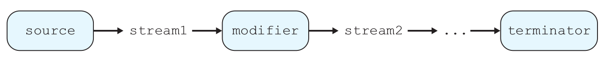
Streams (19.3)
stream: A sequence of elements from a data source that supports aggregate operations.
Streams operate on a data source and modify it:
example: print each element of a collection
example: sum each integer in a file
example: concatenate strings together into one large string
example: find the largest value in a collection
...

Slide 18
Code w/o streams
Non-functional programming sum code:
// compute the sum of the squares of integers 1-5
int sum = 0;
for (int i = 1; i <= 5; i++) {
sum = sum + i * i;
}

Slide 19
The map modifier
The map modifier applies a lambda to each stream element:
higher-order function: Takes a function as an argument.
// compute the sum of the squares of integers 1-5
int sum = IntStream.range(1, 6)
.map(n -> n * n)
.sum();
// the stream operations are as follows:
IntStream.range(1, 6) -> [1, 2, 3, 4, 5]
-> map -> [1, 4, 9, 16, 25]
-> sum -> 55

Slide 20
The filter modifier
The filter stream modifier removes/keeps elements of the stream using a boolean lambda:
// compute the sum of squares of odd integers
int sum =
IntStream.of(3, 1, 4, 1, 5, 9, 2, 6, 5, 3)
.filter(n -> n % 2 != 0)
.map(n -> n * n)
.sum();
// the stream operations are as follows:
IntStream.of -> [3, 1, 4, 1, 5, 9, 2, 6, 5, 3]
-> filter -> [3, 1, 1, 5, 9, 5, 3]
-> map -> [9, 1, 1, 25, 81, 25, 9]
-> sum -> 151

Slide 21
Streams and methods
using streams as part of a regular method:
// Returns true if the given integer is prime.
// Assumes n >= 0.
public static boolean isPrime(int n) {
return IntStream.range(1, n + 1)
.filter(x -> n % x == 0)
.count() == 2;
}

Slide 22
The reduce modifier
The reduce modifier combines elements of a stream using a lambda combination function.
Accepts two parameters: an initial value and a lambda to combine that initial value with each next value in the stream.
// Returns n!, or 1*2*3*...*(n-1)*n.
// Assumes n is non-negative.
public static int factorial(int n) {
return IntStream.range(2, n + 1)
.reduce(1, (a, b) -> a * b);
}

Slide 23
Stream operators
Method name | Description
anyMatch(f) | returns true if any elements of stream match given predicate
allMatch(f) | returns true if all elements of stream match given predicate
average() | returns arithmetic mean of numbers in stream
collect(f) | convert stream into a collection and return it
count() | returns number of elements in stream
distinct() | returns unique elements from stream
filter(f) | returns the elements that match the given predicate
forEach(f) | performs an action on each element of stream
limit(size) | returns only the next size elements of stream
map(f) | applies the given function to every element of stream
noneMatch(f) | returns true if zero elements of stream match given predicate

Slide 24
Stream operators
Method name | Description
parallel() | returns a multithreaded version of this stream
peek(f) | examines the first element of stream only
reduce(f) | applies the given binary reduction function to stream elements
sequential() | single-threaded, opposite of parallel()
skip(n) | omits the next n elements from the stream
sorted() | returns stream's elements in sorted order
sum() | returns sum of elements in stream
toArray() | converts stream into array
Static method | Description
concat(s1, s2) | glues two streams together
empty() | returns a zero-element stream
iterate(seed, f) | returns an infinite stream with given start element
of(values) | converts the given values into a stream
range(start, end) | returns a range of integer values as a stream

Slide 25
Optional results
Some stream terminators like max return an "optional" result because the stream might be empty or not contain the result:
// print largest multiple of 10 in list
// (does not compile!)
int largest =
IntStream.of(55, 20, 19, 31, 40, -2, 62, 30)
.filter(n -> n % 10 == 0)
.max();
System.out.println(largest);

Slide 26
Optional results fix
To extract the optional result, use a "get as" terminator.
Converts type OptionalInt to Integer
// print largest multiple of 10 in list
// (this version compiles and works.)
int largest =
IntStream.of(55, 20, 19, 31, 40, -2, 62, 30)
.filter(n -> n % 10 == 0)
.max()
.getAsInt();
System.out.println(largest);

Slide 27
Stream exercises
Write a method sumAbsVals that uses stream operations to compute the sum of the absolute values of an array of integers. For example, the sum of {-1, 2, -4, 6, -9} is 22.
Write a method largestEven that uses stream operations to find and return the largest even number from an array of integers. For example, if the array is {5, -1, 12, 10, 2, 8}, your method should return 12. You may assume that the array contains at least one even integer.

Slide 28
Closures (19.4)
bound/free variable: In a lambda expression, parameters are bound variables while variables in the outer containing scope are free variables.
function closure: A block of code defining a function along with the definitions of any free variables that are defined in the containing scope.
// free variables: min, max, multiplier
// bound variables: x, y
int min = 10;
int max = 50;
int multiplier = 3;
compute((x, y) -> Math.max(x, min) *
Math.max(y, max) * multiplier);

Slide 29
Streams and arrays
An array can be converted into a stream with Arrays.stream:
// compute sum of absolute values of even ints
int[] numbers = {3, -4, 8, 4, -2, 17,
9, -10, 14, 6, -12};
int sum = Arrays.stream(numbers)
.map(n -> Math.abs(n))
.filter(n -> n % 2 == 0)
.distinct()
.sum();

Slide 30
Method references
ClassName::methodName
A method reference lets you pass a method where a lambda would otherwise be expected:
// compute sum of absolute values of even ints
int[] numbers = {3, -4, 8, 4, -2, 17,
9, -10, 14, 6, -12};
int sum = Arrays.stream(numbers)
.map(Math::abs)
.filter(n -> n % 2 == 0)
.distinct()
.sum();

Slide 31
Streams and lists
A collection can be converted into a stream by calling its stream method:
// compute sum of absolute values of even ints
ArrayList<Integer> list =
new ArrayList<Integer>();
list.add(-42);
list.add(-17);
list.add(68);
list.stream()
.map(Math::abs)
.forEach(System.out::println);

Slide 32
Streams and strings
// convert into set of lowercase words
List<String> words = Arrays.asList(
"To", "be", "or", "Not", "to", "be");
Set<String> words2 = words.stream()
.map(String::toLowerCase)
.collect(Collectors.toSet());
System.out.println("word set = " + words2);
output:
word set = [not, be, or, to]

Slide 33
Streams and files
// find longest line in the file
int longest = Files.lines(Paths.get("haiku.txt"))
.mapToInt(String::length)
.max()
.getAsInt();
stream operations:
Files.lines -> ["haiku are funny",
"but sometimes they don't make sense",
"refrigerator"]
-> mapToInt -> [15, 35, 12]
-> max -> 35

Slide 34
Stream exercises
Write a method pigLatin that uses stream operations to convert a String parameter into its "Pig Latin" form. For example, if the string passed is "go seattle mariners", return "o-gay eattle-say ariners-may".
Write a method fourLetterWords that accepts a file name as a parameter and returns a count of the number of unique lines in the file that are exactly four letters long. Assume that each line in the file contains at least one word.

Slide 35
Sample functional style in C
The sum of integers up to a given integer, imperative:
int sumto(int n) { int i, sum = 0; for(i = 1; i <= n; i++) sum += i; return sum; }
Same function in functional style:
int sumto(int n) { if (n <= 0) return 0; else return sumto(n-1) + n; }

Slide 36
Functional style in C, continued:
Using tail recursion (recursive call occurs as the last operation) and a helper function:
int sumto1(int n, int sum) { if (n <= 0) return sum; else return sumto1(n-1,sum+n); } int sumto(int n) { return sumto1(n,0);}
Accumulating
parameter
Tail call
An optimizer can easily turn tail recursion back into a loop (so tail recursion can be more efficient): int sumto1(int n, int sum) { while (true) if (n <= 0) return sum; else { sum += n; n-=1; } }

Slide 37
Functional style, continued:
The code of last slide changes addition order. With one more parameter we can preserve this order (useful for arrays and non-commutative ops):
int sumto1(int n, int i, int sum) { if (i > n) return sum; else return sumto1(n,i+1,sum+i); } int sumto(int n) { return sumto1(n,1,0); }
Array example (summing an array of ints in Java):
static int sumto1(int[] a,int i,int sum) { if (i >= a.length) return sum; else return sumto1(a,i+1,sum+a[i]); } static int sumto(int[] a) { return sumto1(a,0,0);}

Slide 38
Scheme: A Lisp dialect
Syntax (slightly simplified):
expression → atom | list
atom → number | string | identifier | character | boolean
list → '(' expression-sequence ')'
expression-sequence → expression expression-sequence | expression
That’s it! In Scheme, everything is an expression: programs, data, you name it. And there are only two basic kinds of expressions: atoms and lists (unstructured and structured). Lists are the only structure (a slight simplification -- but not by much).

Slide 39
Scheme Sample Expressions
42 —a number
"hello" —a string
#T —the Boolean value "true"
#\a —the character 'a'
(2.1 2.2 3.1) —a list of numbers
a —an identifier
hello —another identifier
(+ 2 3) —a list consisting of the identifier "+" and two numbers
(∗ (+ 2 3) (/ 6 2)) —a list consisting of an identifier followed by two lists

Slide 40
Scheme Evaluation
Scheme programs are executed by evaluating expressions. A Scheme program consists of a series of expressions that are loaded and executed by the interpreter. Typically, all but the last of these expressions are definitions, and the last one (often entered directly) launches the program (much like main does in Java and C).
The interpreter runs in a loop, called the “read-eval-print” loop: it reads an expression, evaluates it, and prints the result. Then it is ready to read a new expression. Read, eval, and print can also be called directly by programs. In fact, the interpreter is usually written in Scheme too (called a metacircular interpreter).

Slide 41
Scheme evaluation rule
1. Constant atoms, such as numbers and strings, evaluate to themselves.
2. Identifiers are looked up in the current environment and replaced by the value found there. (The environment in Scheme is essentially a dynamically maintained symbol table that associates identifiers to values.)
3. A list is evaluated by recursively evaluating each element in the list as an expression (in some unspecified order); the first expression in the list must evaluate to a function. This function is then applied to the evaluated values of the rest of the list. Thus, all expressions are in prefix form.

Slide 42
Comparison of C to Scheme
C Scheme
3 + 4 ∗ 5 (+ 3 (∗ 4 5))
(a == b) (and (= a b)
&& (a != 0) (not (= a 0)))
gcd(10,35) (gcd 10 35)
gcd gcd
getchar() (read-char)

Slide 43
Evaluation rule, continued
The Scheme evaluation rule is essentially the same as C or Java: arguments are evaluated at a call site before they are passed to the called function.
This is usually called “applicative order evaluation”, or “eager” evaluation.
Other kinds of evaluation delay the evaluation of the arguments.

Slide 44
Examples of delayed evaluation in Scheme
The if function (if a b c): a is always evaluated, and, depending on whether the result is #t or #f, either b or c is evaluated and returned as the result.
The define function (define x (+ 2 3)): this defines top-level names; the second expression is always evaluated, the first expression is never evaluated -- it must be a name whose value becomes the value of the second expression.
Such functions are called special forms or keywords.

Slide 45
The quote special form
Quote, or ' for short, has as its whole purpose to not evaluate its argument: (quote (2 3 4)) returns just (2 3 4).
Another way to write this is '(2 3 4).
Quote is used to create data constants directly by “canceling” evaluation.
We can in fact get evaluation back again: (eval '(+ 2 3)) returns 5.
More special forms: cond and let: similar to switch and {...} in Java and C.

Slide 46
Scheme code examples
(define a 2)
(define emptylist '())
(define (gcd u v) ;defines a function
(if (= v 0) u
(gcd v (remainder u v))))
(cond((= a 0) 0) ;if (a==0) return 0;
((= a 1) 1) ;elsif(a==1)return 1;
(else (/ 1 a))) ; else return 1/a;

Slide 47
Scheme examples, continued
; Figure 11.7, pages 486-487
(define (euclid)
(display "enter two integers:")
(newline)
(let ((u (read)) (v (read)))
(display "the gcd of ")
(display u)
(display " and ")
(display v)
(display " is ")
(display (gcd u v))
(newline)))

Slide 48
Special form syntax can be tricky
if is easy - it always takes three expressions as parameters: (if a b c)
cond is not so easy - it takes an arbitrary sequence of expressions, each of which is a list of two (or more) items: (cond (e1 v1 …) (e2 v2 …) …)
define has two forms - (define a b): a must be a name (define (a …) b1 b2 …): defines function a with body the sequence b1, b2, etc.
let has implicit sequences too: (let ((n1 e1) (n2 e2) …) v1 v2 …)

Slide 49
Lists in Scheme
Lists are (essentially) the only data structure in Scheme (like arrays in Algol60). However, lists are very versatile and can be used to model any other data structure.
Lists are constructed recursively using the empty list '() and the cons binary operator: (1 2 3) = (cons 1 (cons 2 (cons 3 '())))
The first element of a list (its head) is returned by the car operator: (car '(1 2 3)) = 1
The tail of a list is returned by the cdr operator: (cdr '(1 2 3)) = (2 3)

Slide 50
List Examples:
cdr down
(define (append L M)
(if (null? L) M
(cons (car L) (append (cdr L) M))))
(define (reverse L)
(if (null? L) '()
(append (reverse (cdr L)) (list (car L)))))
(define (square-list L)
(if (null? L) '()
(cons (* (car L) (car L)) (square-list (cdr L)))))
Predicate function
cons up
Creates a list out
of a sequence

Slide 51
Data structures in Scheme
Since lists can recursively contain other lists, lists can model any recursive data structure:
(define L '((1 2) 3 (4 (5 6))))
(car (car L)) => 1
(cdr (car L)) => (2)
(car (car (cdr (cdr L)))) => 4
Note: car(car = caar cdr(car = cdar car(car(cdr(cdr = caaddr

Slide 52
Box diagrams: a visual aid
L = ((1 2) 3 (4 (5 6))) looks as follows in memory (notice how everything is a pointer):

Slide 53
Binary search trees
Represent each node as a 3-item list (data left-child right-child): (define (data B) (car B)) (define (leftchild B) (cadr B)) (define (rightchild B) (caddr B))
Example - see Figure 11.8, page 487: ("horse"("cow"()("dog"()())) ("zebra"("yak"()())()))
Now we can write traversals such as (define (tree-to-list B) (if (null? B) B (append (tree-to-list (leftchild B)) (list (data B)) (tree-to-list (rightchild B)))))

Slide 54
Equality in Scheme
Scheme has many different equality functions:
= applies only to numbers
char=? applies only to characters
string=? applies only to strings
In general, every non-numeric data type has its own equality function
There are also three “generic” equality functions: eq?, eqv?, and equal? The last function is the most general, testing structural equality similar to Object.equal() in Java; use this always for lists. The other two test identity in memory, similar to == applied to objects in Java.

Slide 55
Equality of functions in Scheme
Testing functions for equality is tricky:
(define (f x) x)
(define (g x) x) ; clearly g = f
(define (h y) (car (list y)))
; now h = f too, but how to tell?
Thus, most Scheme versions decide that functions are never equal unless they occupy the same memory:
(equal? f g) => #f
(define k f)
(equal? f k) => #t

Slide 56
Eval and symbols
The eval function evaluates an expression in an environment; many Scheme versions have an implied current environment: (eval (cons max '(1 3 2)) => 3
Symbols are virtually unique to Lisp: they are runtime variable names, or unevaluated identifiers: 'x => x (eval 'x) => the value of x in the environment
Use symbols for enums (they are more efficient than strings)

Slide 57
Lambda expressions/function values
A function can be created dynamically using a lambda expression, which returns a value that is a function (aka procedure): > (lambda (x) x) #<procedure>
The syntax of a lambda expression is (lambda list-of-parameters exp1 exp2 …)
Indeed, the "function" form of define is just syntactic sugar for a lambda: (define (f x) x) is equivalent to: (define f (lambda (x) x))

Slide 58
Function values as data
The result of a lambda can be manipulated as ordinary data:
> ((lambda (x) (* x x)) 5)
25
(define f (list (lambda () 2)))
> f
(#<procedure>)
> (eval f)
2
> (define (add-x x) (lambda(y)(+ x y)))
> (define add-2 (add-x 2))
> (add-2 15)
17

Slide 59
Higher-order functions
Any function which returns a function as its value, or takes a function as a parameter, or both is called "higher-order"
The add-x function of the previous slide is higher-order
Eval is higher-order
The use of higher-order functions is characteristic of functional programs

Slide 60
Higher-order examples
(define (compose f g)
(lambda (x) (f (g x))))
(define (map f L)
(if (null? L) L
(cons (f (car L))(map f (cdr L)))))
(define (filter p L)
(cond
((null? L) L)
((p (car L)) (cons (car L)
(filter p (cdr L))))
(else (filter p (cdr L)))))

Slide 61
Let expressions as lambdas:
A let expression is really just a lambda applied immediately: (let ((x 2) (y 3)) (+ x y)) is the same as ((lambda (x y) (+ x y)) 2 3)
This is why the following let expression is an error if we want x = 2 throughout: (let ((x 2) (y (+ x 1))) (+ x y))
To compensate, there are sequential and recursive lets: let* and letrec

Slide 62
Pitfalls of wildcards
String myString;
Object myObject;
List<?> c = new ArrayList<String>();
// c.add("hello world"); // compile error
// c.add(new Object()); // compile error
((List<String>) c).add("hello world");
((List<Object>) c).add(new Object()); // no compile error!
// String myString = c.get(0); // compile error
myString = (String) c.get(0);
myObject = c.get(0);
myString = (String) c.get(1); // run-time error!
Notes:
Since we do not know what the element type of c stands for, we cannot add Objects.
However we can get objects as we always know the type is of type Object

Slide 63
Bounded Wildcards
Consider a simple drawing application to draw shapes (circles, rectangles,…)
Shape
draw(Canvas)
Canvas
draw(Shape)
drawAll(List<Shape>)
Circle
Rectangle
Limited to
List<Shape>
Notes:
Any drawing will typically contain a number of shapes. Assuming that
They are represented in a list, it would be convenient to have a method
In canvas that draws them all.
However drawAll can only be called for list of Shape not list of circles.
We want the method to accept a list of any shape.

Slide 64
A Method that accepts a List of any kind of Shape…
public void drawAll(List<? extends Shape>) {…}
a bounded wildcard
Shape is the upper bound of the wildcard
Notes:
? Unknown type - we know that the unknown type is a subtype of Shape.

Slide 65
More fun with generics
import java.util.*;
…
public void pushAll(Collection<? extends E> collection) {
for (E element : collection) {
this.push(element);
}
}
public List<E> sort(Comparator<? super E> comp) {
List<E> list = this.asList();
Collections.sort(list, comp);
return list;
}
All elements must be at least an E
The comparison method must require at most an E
Notes:
? extends E matches anything that is a subclass of E (including E)
? super E matches anything that is a superclass of E (including E)

Slide 66

Roadmap
Generics
Annotations
Model-Driven Engineering

Slide 67
Annotations
Annotations are a special kind of comment
As with comments, annotations do not change or affect the semantics of the program, i.e. the runtime behavior.
Annotations are meta-descriptions
Unlike comments, annotations can be accessed and used by third-party tools (e.g. JUnit) or even your program itself.
Notes:
http://www.developer.com/java/other/article.php/626001

Slide 68
JUnit uses annotations
@Before
public void setup() { …
@Test
public void someTest() { …
@Test(expected=IOException.class)
public void anotherTest() { …
JUnit uses annotations to find out which methods are test methods, and which are part of the setup. You may even pass parameters to the annotations.
Notes:
http://www.developer.com/java/other/article.php/626001

Slide 69
Roadmap
Generics
Annotations
Model-Driven Engineering

Slide 70
The Vision of MDE
Platform
Independent
Model
software
developer
automatic
translation

Slide 71
Example: a model-driven UI
We want a UI to edit any kind of object with any kind of properties (i.e. Model-driven Engineering)
The example requires these steps
Define custom annotations for getters and setters.
Annotate our classes with these annotations
Write a UI class that access these annotations at runtime to create a custom UI
Notes:
http://www.developer.com/java/other/article.php/626001

Slide 72
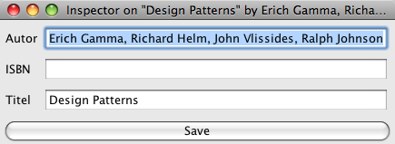
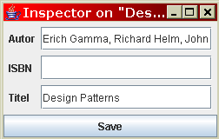
Model-driven Engineering
:Book
model-driven
title: String
author: String
…
Model
can be any kind of object
with any kind of properties
Model-driven UI
labels and field are automatically
created based on the model
Notes:
http://www.developer.com/java/other/article.php/626001

Slide 73
Defining our custom annotations
import java.lang.annotation.*;
@Retention(RetentionPolicy.RUNTIME)
@Target(ElementType.METHOD)
public @interface GetProperty { public String value();
}
This defines a @GetProperty annotation for methods. The annotation is accessible at runtime.
Notes:
http://www.developer.com/java/other/article.php/626001

Slide 74
Annotating our domain classes
@GetProperty(“Titel”)
public void getTitle() {
return title;
}
@GetProperty(“Autor”)
public void getAuthor() {
return author;
}
…
Notes:
http://www.developer.com/java/other/article.php/626001

Slide 75
Use reflection to access the annotations of any object
import java.reflect.Method;
public void printAnnotatedMethods(Object obj) {
for (Method m : obj.getClass().getMethods()) {
if (m.isAnnotationPresent(GetProperty.class)) {
this.processProperty(obj, m);
}
}
}
The for loop iterates over all methods of obj’s Class.
The if block is only entered for annotated methods.
Notes:
http://www.developer.com/java/other/article.php/626001
See Debug.printAll()

Slide 76
Use reflection to call any method of any object
import java.reflect.Method;
public void processProperty(Object obj, Method m)
throws Exception {
GetProperty g = m.getAnnotation(GetProperty.class);
this.add(new Jlabel(g.value()));
String value = (String) m.invoke(obj);
this.add(new JTextField(value));
}
We use reflection to invoke the method m on the
object obj.
Notes:
http://www.developer.com/java/other/article.php/626001
See Debug.printProperty()

Slide 77
What you should know!
Why do I need generics?
Why is casting dangerous?
How do I use generics?
Can I subtype a generic type?
When is the Abstract Factory pattern useful?
Some uses of Annotations?
A Model-Driven Engineering Example

Slide 78
9) Principle for Usable Design & Usability Metrics

Slide 79
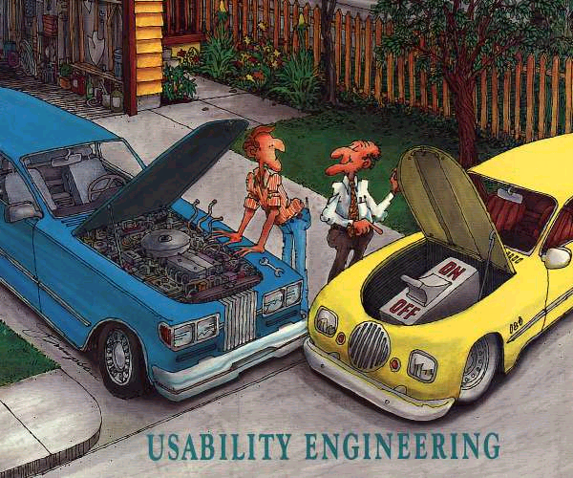

Slide 80
Usability Engineering Lifecycle (Nielsen)
Know the User
Competitive Analysis
Set Usability Goals
Parallel Design
Participatory Design
Co-ordinated Design of Total Interface
Applying Guidelines
Prototyping
Usability Evaluation (Inspection and Testing)
Iterative Design
Follow-up Studies

Slide 81
1. Know the User
Observe Users in Working Environment: Site visits, unobtrusive observation. Don't believe their superiors!
Individual User Characteristics: Classify users by experience (see next slide), educational level, age, amount of prior training, etc.
Task Analysis: Users' overall goals, current approach, model of task, prerequisite information, exceptions to normal work flow.
Functional Analysis: Functional reason for task: what really needs to be done, and what are merely surface procedures?
Evolution of User and Task: Users change as they use system, then use system in new ways.
Draw up set of typical user scenarios to set the scene for brainstorming, thinking aloud, or cognitive walkthrough, etc.

Slide 82
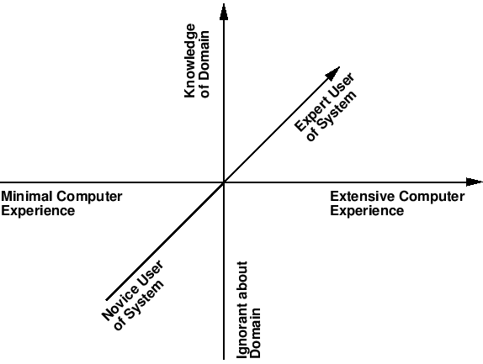
Categories of User Experience

Slide 83
2. Competitive Analysis
Competitive analysis of software components:
Use existing interface framework as far as possible (Motif, MS-Windows, Java AWT) - saves a lot of work.
Use existing components and applications rather than re-inventing the wheel.
Competitive analysis of competing systems:
Analyse competing products heuristically or empirically.
“Intelligent borrowing” of ideas from other systems.

Slide 84
3. Set Usability Goals
Decide in advance on usability metrics and desired level of measured usability (usability goal line).
Financial impact analysis - estimate savings based on loaded cost of users, compared to cost of usability effort.

Slide 85
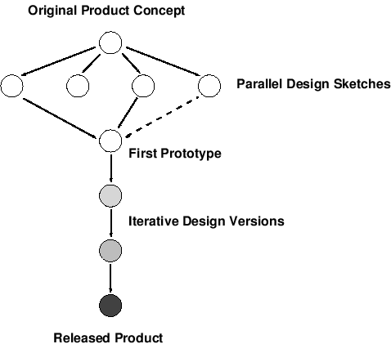
4. Parallel Design
Explore design alternatives - designers should work independently, then compare draft designs.
Brainstorm with whole team (engineers, graphic designer, writer, marketing types, usability specialist, one or two representative users).

Slide 86
How To Brainstorm
Meet away from usual workplace (different building, hut in the mountains).
Use plenty of paper. Cover the walls with it!
Draw. Scribble. Use lots of coloured pens.
Three rules during brainstorming:
No one is allowed to criticise another's ideas.
Engineers must not say it can't be implemented.
Graphic designer must not laugh at engineers' drawings.
Only after brainstorming, organise ideas and consider their practicality and viability.

Slide 87
5. Participatory Design
Have access to pool of representative users.
Users become first class members in design process
active collaborators vs passive participants
Users considered subject matter experts
know all about the work context
Iterative process
all design stages subject to revision
Guided discussion of prototypes, paper mock-ups, screen designs with representative users.
Similar to JAD though of British/Scandinavian origin

Slide 88
5. Participatory Design (contd)
Users are excellent at reacting to suggested system designs
Designs must be concrete and visible
Users bring in important “folk” knowledge of work context
Knowledge may be otherwise inaccessible to design team
Greater buy-in for the system often results
Hard to get a good pool of end users
Expensive, reluctance ...
Users are not expert designers
Don’t expect them to come up with design ideas from scratch
The user is not always right
Don’t expect them to know what they want

Slide 89
Methods of Involving Users
At the very least, talk to users
Surprising how many designers don’t!
Interviews
Used to discover user’s culture, requirements, expectations, etc.
Contextual inquiry:
Interview users in their workplace, as they are doing their job
Explain designs
Describe what you’re going to do
Get input at all design stages
all designs subject to revision
Important to have visuals and/or demos
People react far differently with verbal explanations

Slide 90
6. Coordinated Design of Total Interface
Consistency across total interface: documentation, online help, tutorials, videotapes, training classes as well as screens and dialogues. By means of:
Interface standards: specific rules as to how interface should look and feel.
Widget libraries: shared code implementing standard UI functionality.
Shared culture: training, meetings, “interface evangelist”

Slide 91
7. Applying Guidelines
Guidelines ...general principles and advice about usability characteristics of interfaces:
Smith S. & Mosier J.; Design Guidelines for Designing User Interface Software; The MITRE Corp., 1986. [944 guidelines] ftp://ftp.cis.ohio-state.edu/pub/hci/Guidelines
Brown C.; Human-Computer Interface Design Guidelines; Ablex, NJ, 1988. [302 guidelines]
Mayhew D.; Principles and Guidelines in Software User Interface Design; Prentice-Hall, 1991. [288 guidelines]
Can be intimidating - often hundreds or thousands of specific recommendations.
Many conflicting guidelines
Impractical for rapid design.

Slide 92
8. Prototyping
Perform usability evaluation as early as possible in the design cycle by building and evaluating prototypes.
Prototypes cut down on either the number of features, or the depth of functionality of features:
Vertical Prototype: in-depth functionality for a few selected features.
Horizontal Prototype: full interface features, but no underlying functionality.
Scenario: only features and functionality along a pre-specified scenario (task) or path through the interface. “Description of an individual user using specific computer facilities to achieve a specific outcome under specified circumstances along a certain time dimension.”

Slide 93
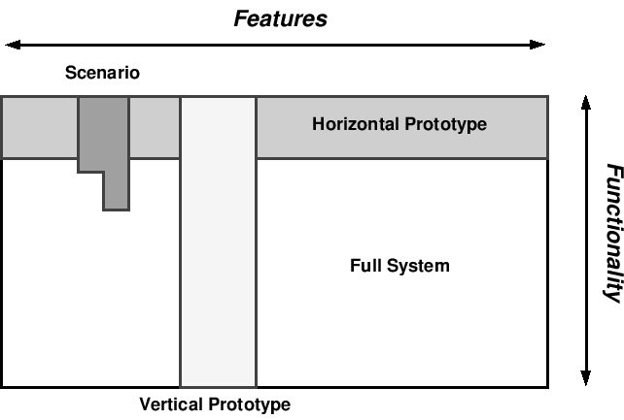
Dimensions of Prototyping

Slide 94
Prototyping
Early Design
Brainstorm different representations
Choose a representation
Rough out interface style
Task centered walkthrough and redesign
Fine tune interface, screen design
Heuristic evaluation and redesign
Usability testing and redesign
Limited field testing
Alpha/Beta tests
Low fidelity paper prototypes
Medium fidelity prototypes
High fidelity prototypes / restricted systems
Working systems
Late Design

Slide 95
9. Usability Evaluation
Usability Inspection Inspection of interface design using heuristics and judgement (no user tests).
Heuristic evaluation
Cognitive walkthroughs
Usability Testing Empirical testing of interface design with real users.
Paper and pencil tests
Formal experiments
Thinking aloud protocol analysis
Query techniques

Slide 96
10. Iterative Design
Severity ratings of usability problems discovered via empirical testing.
Fix problems in new iteration of interface.
Capture design rationale: record reasons why changes were made. (gIBIS¹) (Carroll & Rosson²)
Evaluate new version of interface.
Design, test, redesign. ¹See Dix et al 2nd Ed. p.214 ²Psychological Design Rationale

Slide 97
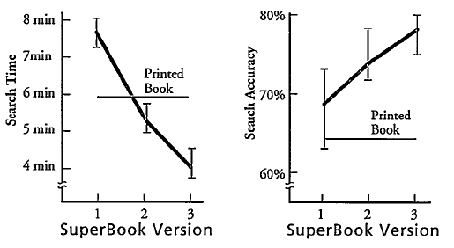
Benefits of Iterative Design
Iterative Design Improvement with SuperBook. (Egan et al.) ACM Trans. Information Systems 7(1), Jan., 1989 pp. 30-57.

Slide 98
11. Follow-Up Studies
Important usability data can be gathered after the release of a product for the next version:
Specific field studies (interviews, questionnaires, observation).
Standard marketing studies.
Instrumented versions of software log data.
Analyse user complaints, modification requests, bug reports. (Therac-25)

Slide 99
Planning Usability Activities
Prioritise activities.
Write down explicit plan for each activity.
Subject plan to independent review (e.g. colleague from different project).
Perform pilot activity with about 10% of total resources, then revise plan for remaining 90%. [Always perform a pilot study!]

Slide 100
Summary
User-centered design is different than traditional methodologies
Iterative prototype + evaluate
Prevents problems up front
Know the user and involve them in design

